Slide 1
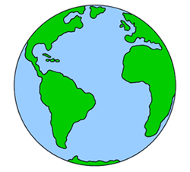
Magnetic fields
Content Development
Draw the magnetic field of the Earth
Think about what a magnetic field line means
(where does the North pole of a compass point?)

Slide 2
Magnetic fields
Content Development
The magnetic field lines at the magnetic poles is similar to the gravitational field lines at the surface of the Earth – they act parallel but at an angle to the surface
Magnetic field lines are declined in the northern hemisphere.
Magnetic field lines are inclined in the southern hemisphere.
N
S
θ
θ
Geographic North
Geographic South

Slide 3
Magnetic fields
Content Development
A sensitive magnetic based experiment is being conducted in a region where the Earth’s magnetic field is decline at 19.0º and has a density of 58.0 μT.
Which hemisphere is the experiment being conducted?
Calculate the component of the Earth’s magnetic field parallel with the surface in the region.
Notes:
North
Bh = B cos 19 = 5.48x10^-5 T

Slide 4
Motion in magnetic fields
Success Criteria
I can draw the magnetic field generated by a solenoid.
I can draw the Earth's magnetic field.
I can perform vector calculations of Earth's magnetic field.
I can describe the motion of charged particles in a magnetic field.

Slide 5
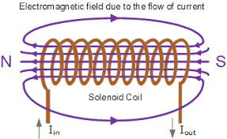
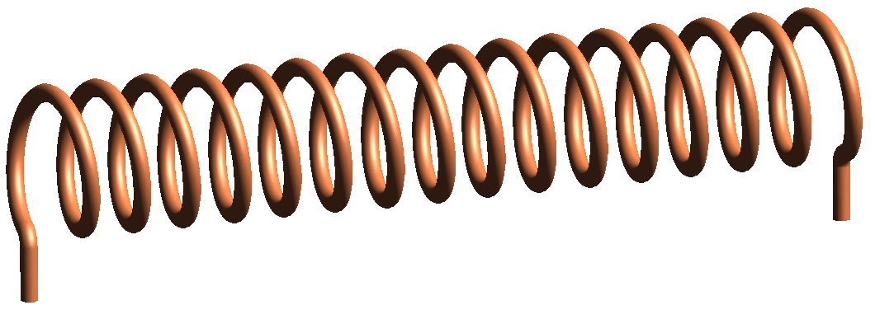
Solenoids
Content Development
If many loops are placed side by side, their fields all add and there is a much stronger effect. This can be done by winding many turns of wire into a coil, called a solenoid. The field around the solenoid is like the field around a normal bar magnet.
Notes:
Straight wire produces a circular magnetic field that quickly weakens as you move away from the wire - not a very useful field for practical purposes.
In a single loop, the magnetic field is magnified in the centre of the loop but is still not strong enough.
By twisting the wire into a large number of helical coils (spirals) a magnetic field of a permanent magnet can be simulated. This electromagnet (or solenoid) is strong enough to replace permanent magnets and as the number of coils is increased, a very powerful magnet can be created that has the advantage of being able to be switched off.

Slide 6
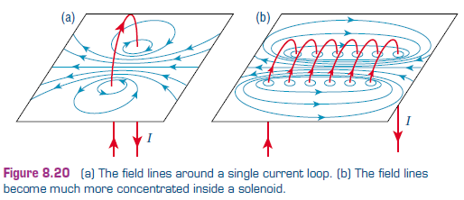
Solenoids
Content Development
If many loops are placed side by side, their fields all add and there is a much stronger effect. This can be done by winding many turns of wire into a coil, called a solenoid. The field around the solenoid is like the field around a normal bar magnet.

Slide 7
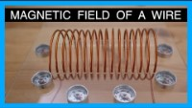
Solenoids
Content Development

Slide 8
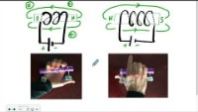
Solenoids
Content Development

Slide 9
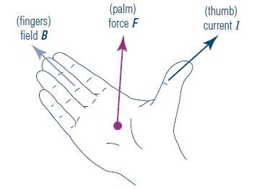
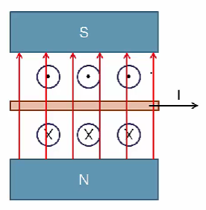
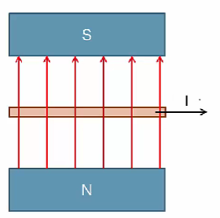
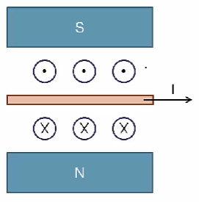
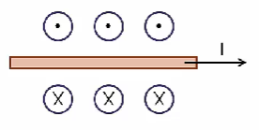

Lorentz Force
Content Development
A current carrying conductor in an external magnetic field will experience a force. Remember, the current is creating a magnetic field. This interacts with the external magnetic field, like two magnets would.
Thumb always points towards conventional current. Fingers always points in direction of field. Palm is the force direction.
Notes:
https://www.youtube.com/watch?v=nRDVm5rn_2A&ab_channel=NationalMagLab

Slide 10
Lorentz Force
Content Development
It is very important not to get the two right-hand rules mixed up, as they apply to quite different situations.
The right-hand grip rule tells us the direction of the circular magnetic field that occurs around a current carrying conductor. This field is created by the current.
The right-hand force rule (sometimes called the right-hand palm rule or just the right-hand rule) tells us the direction of the force on a current in a magnetic field. This force is the result of putting a current in a magnetic field. Don’t confuse it with the field created by the current itself.
Notes:
https://www.youtube.com/watch?v=nRDVm5rn_2A&ab_channel=NationalMagLab

Slide 11
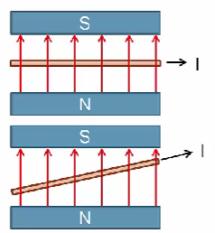
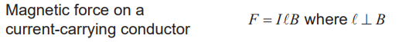
Lorentz Force
Content Development
B = Magnetic Field strength (T)
l = Length of wire in the field (m)
I = Current (A)
F = force (N)
The length of wire perpendicular to the field is used.
Notes:
https://www.youtube.com/watch?v=nRDVm5rn_2A&ab_channel=NationalMagLab

Slide 12
Lorentz Force
Content Development
A 5.00m power line carries a 88.0 A current running from east to west. The Earth’s magnetic flux density in this area is 5.00 x 10⁻⁵ T. Calculate the force acting on the wire.
Notes:
Assume no inclination.
West to the left, north up. Palm pushes into page which is the ground here.
F = current*length*B = 2.20 * 10^-2 N

Slide 13
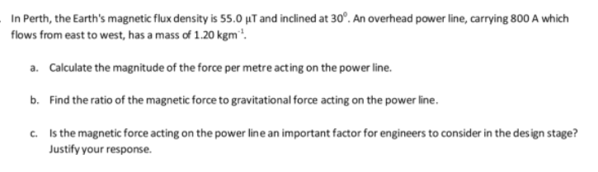
Lorentz Force
Content Development

Slide 14
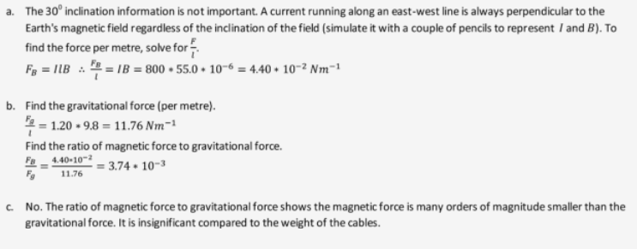
Lorentz Force
Content Development

Slide 15
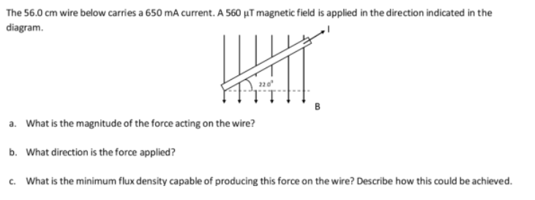
Lorentz Force
Content Development

Slide 16
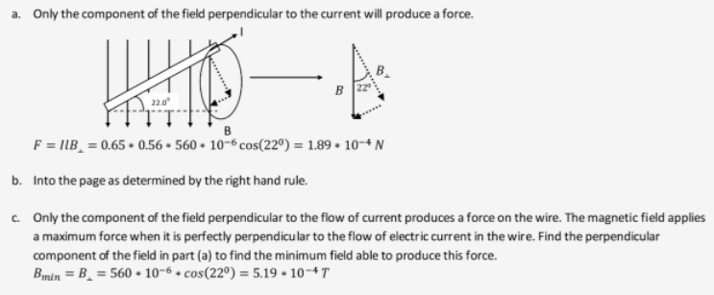
Lorentz Force
Content Development
Notes:
https://www.youtube.com/watch?v=nRDVm5rn_2A&ab_channel=NationalMagLab

Slide 17
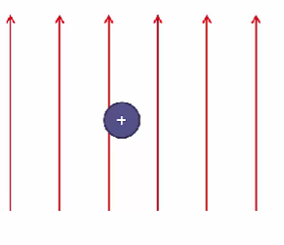
Force on a charge moving through a magnetic field
Content Development
Any charge moving through an external magnetic field will always experience a force on it. A moving charge creates a magnetic field which interacts with the external field to exert a force.
The concepts for current-carrying wires, the same rules apply.
v
Remember: conventional current is positive. It is the flow of positive charge!
Notes:
Compare to an electron travelling. Can you left hand or just flip where your thumb points (point to flow of positive)

Slide 18
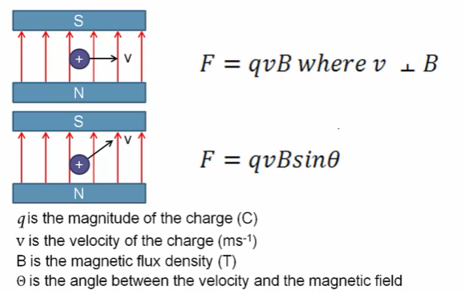
Lorentz Force
Content Development

Slide 19
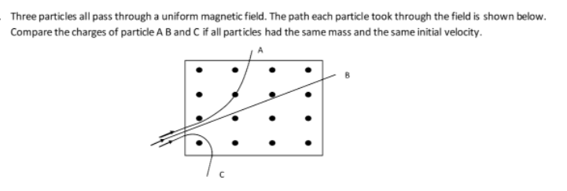
Lorentz Force
Content Development

Slide 20
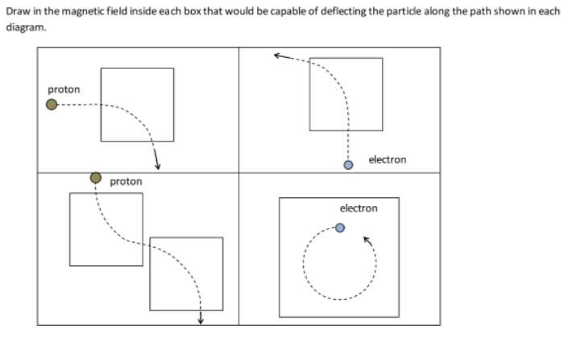
Lorentz Force
Content Development

Slide 21
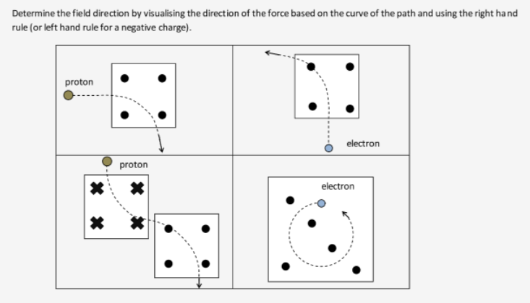
Lorentz Force
Content Development

Slide 22
Homework
Notes:
https://ophysics.com/em7.html
https://ophysics.com/em8.html

